Slide 1
Vehicle Rental in India

Slide 2
Hardware Requirement:-
Pentium-IV
256 MB Ram
512 KB Cache Memory
Hard disk 20 GB
Microsoft Compatible 101 or more key board
Software Requirements:-
Software's : Sublime text, XAMP control panel.
Programming language : HTML,CSS,PHP,
Web-Technology : PHP
Front-End : PHP,HTML
Back-End: MY SQL
Web-Server : XAMP Server

Slide 3
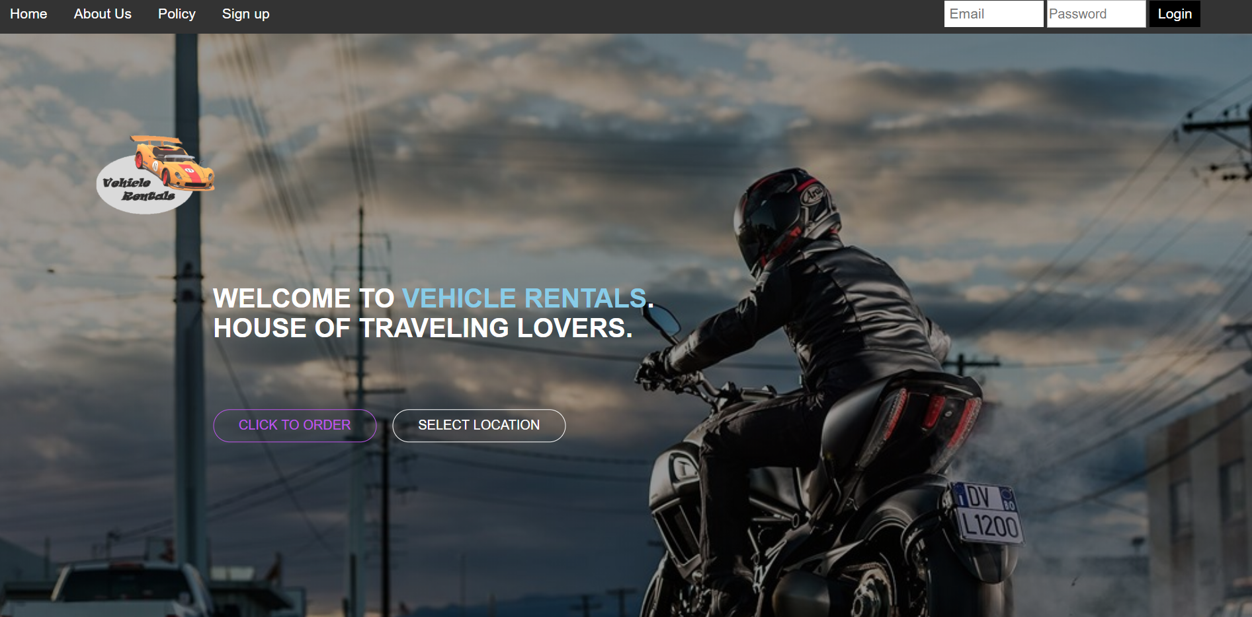

Home
As the home page is the which has to be link with many of pages of website . So, the few navigation links are shown at the top left corner. And the logo of the organization is at the top left.

Slide 4
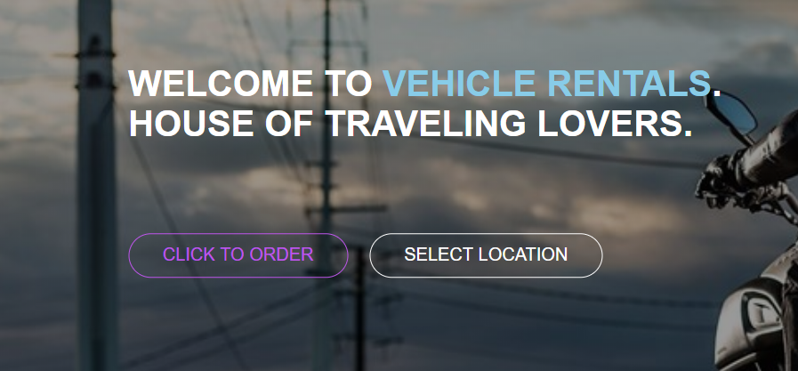
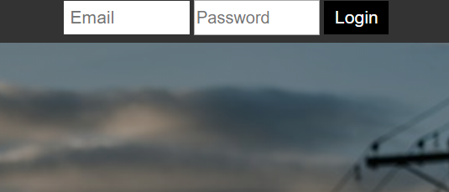
A beautiful welcome statement is shown below . And just below the welcome thought the two more navigation links of different pages are added. And the attractive background bikes image is set.
And the login field is display at the right corner of the home page. After the login the logout button will be display on that palce.

Slide 5
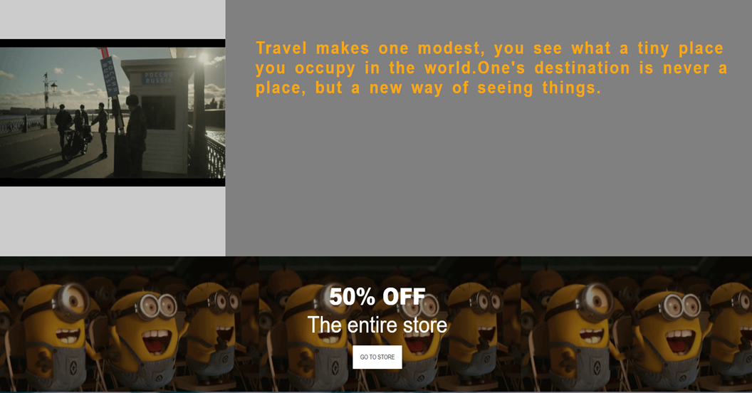
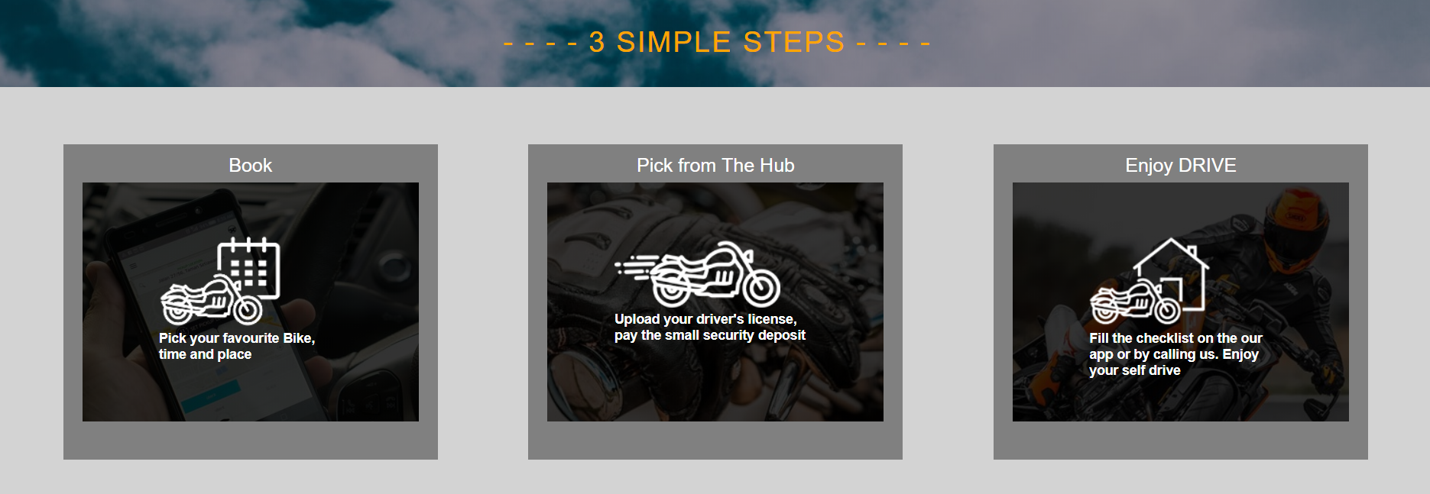
Then the background bikes video is display and right side of it a slogan is display about enjoyment while riding bikes. The exciting thing that every website contains is offers, are display with the crazy minions at the background gif .The offers always attracts people so we have shown the 50% off offer in our website.
The step to book the vehicle from our website are display so the users may not get confuse and they will understand easily how to book vehicles.

Slide 6
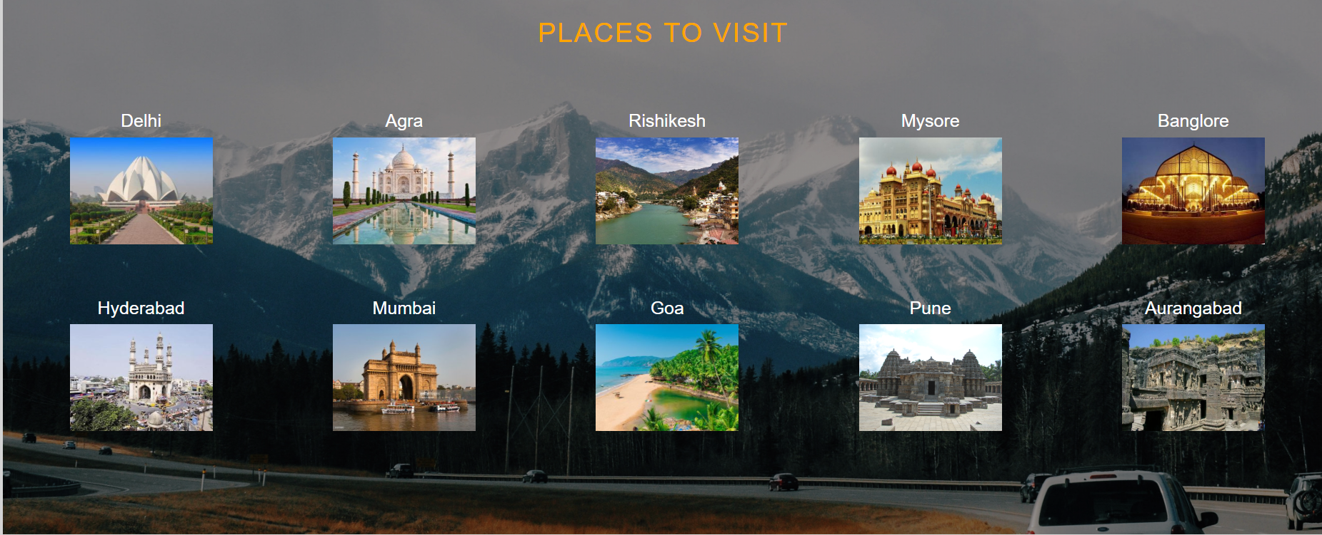
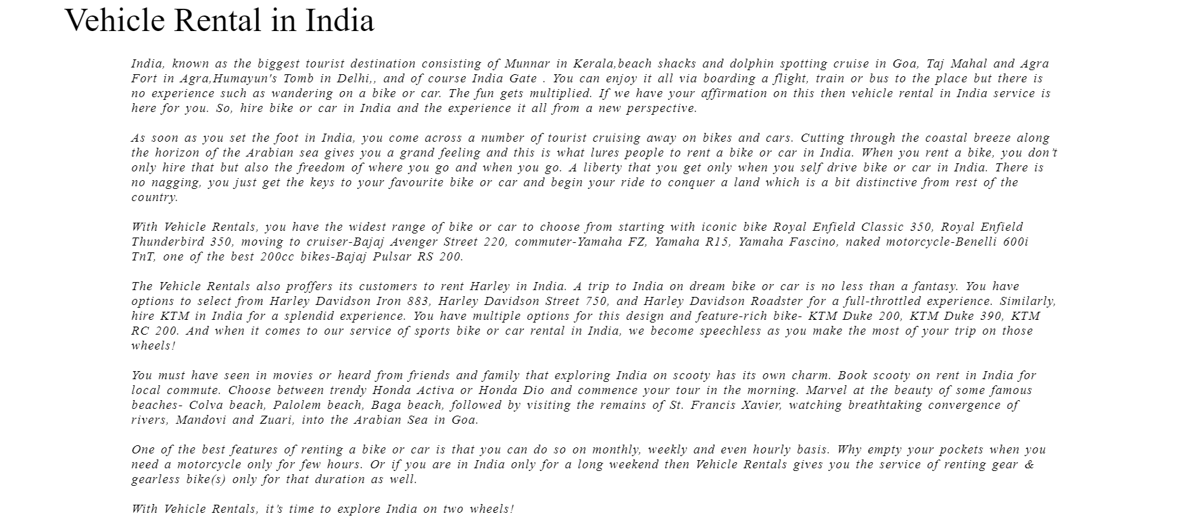
As the website is about vehicle rent to ride over different place to make our days .So the best places to visit in India are display. Everyone in world knows that Taj Mahal is one of the seven wonders of the world . Some more beautiful place are display.
At the last that every website has is the details of the website are given and the contact information is display .

Slide 7
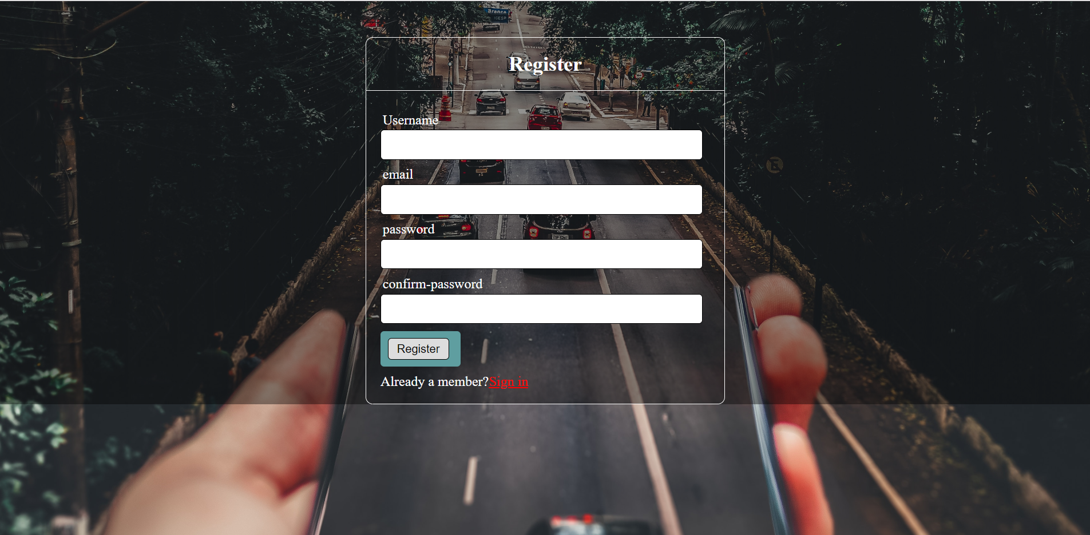
Registration
The registration is required to make the login id for the specific website. So the registration page in our website four text fields are display where user have to enter his/her name ,email, password and confirm password. These detail are required compulsory to register in our website .
As you can se in our website that the registration and login are much similar to each other in design .In fact the background is also similar .
The button is display below the confirm password field , when user will click on it his /her account will get register in our website . If the user already have the account in our website .Then he/she can select the sign in option which display just below the register button.

Slide 8

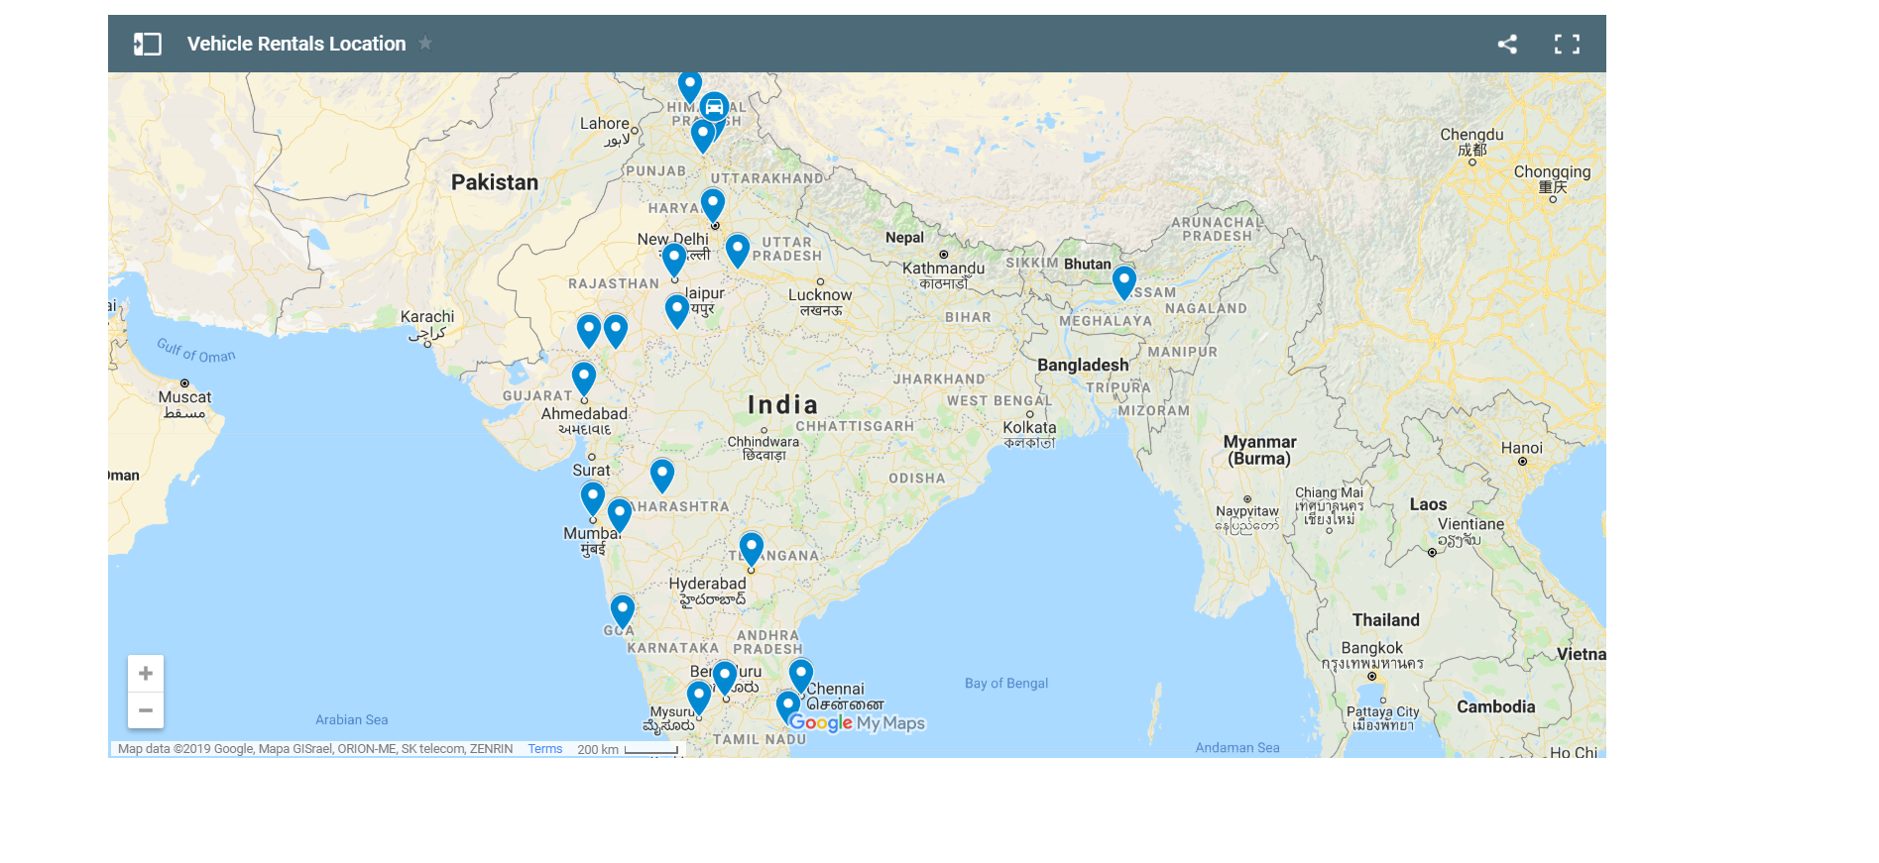
Map Location
The map page in our project is something new that we have applied in our project. The basically shows that where vehicle rental hubs are located.
A user can check whether there is a hub of vehicle rentals is their or not by looking to a map one can easily check whether its near by or not.
If one doesn’t found a near by hub then he can checked which is the nearest hub is their around him or where he wants to go. Then he can checked whether he can afford a rental or not. By checking it he can make sure whether its an affordable rental is or not.

Slide 9
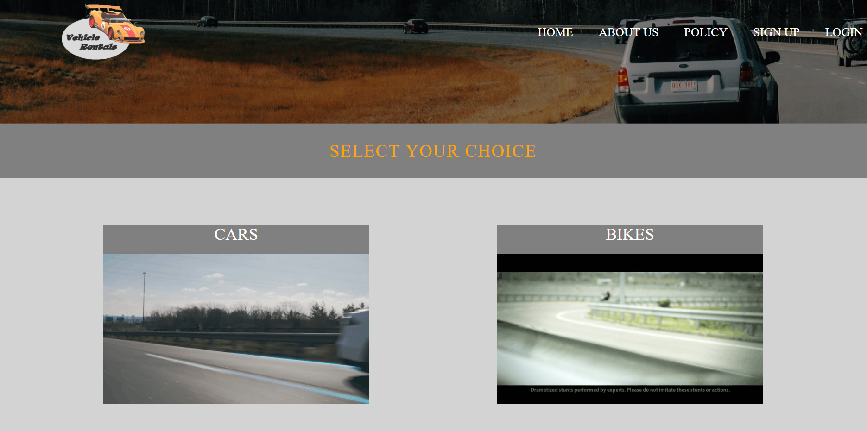
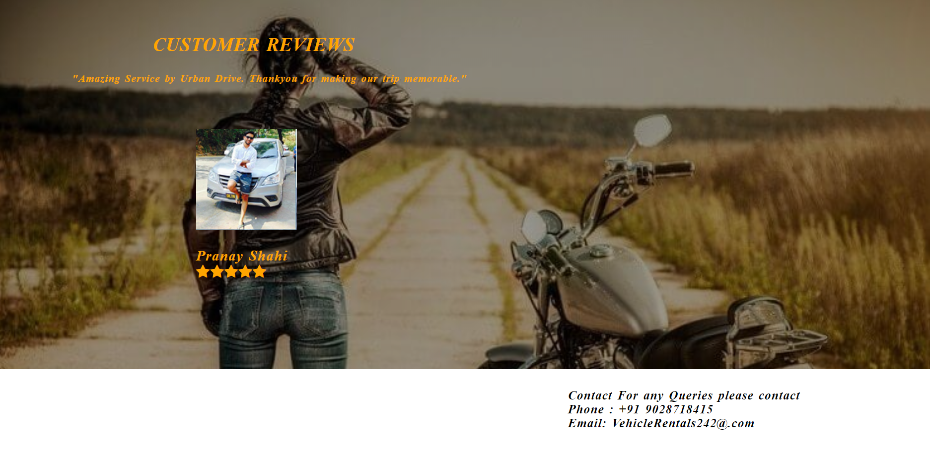
Select Option
In this form the two options are display.
Cars and Bikes through which he/she can order the vehicle. And the customers reviews is shown just below it.

Slide 10
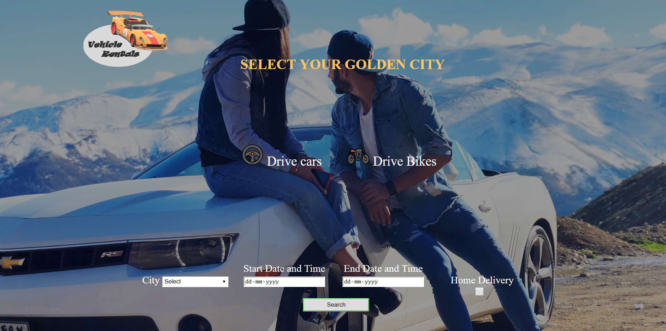
Select Location
In this form the city location have to select.
Where the starting date of the booking vehicle and the end date of the vehicle.
The check box is also display so if he/she want the home delivery they can select this option.

Slide 11
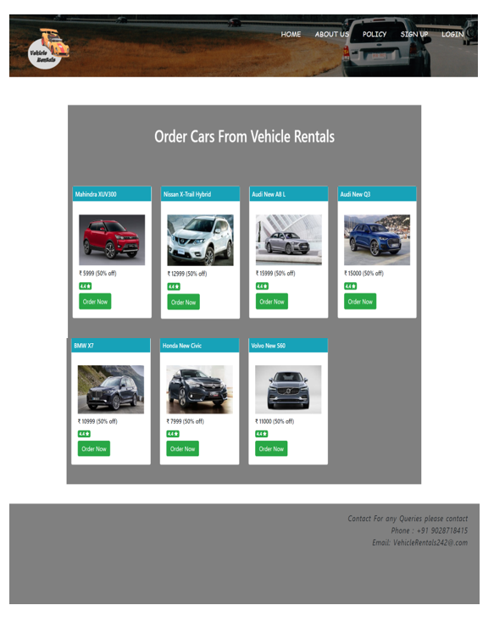
Order Cars
The cars are contain are under 50% off offer .
This form contains the car which the user can order cars of his /her choice.
And the rattings of the car are also shown so the user can make proper choice.

Slide 12
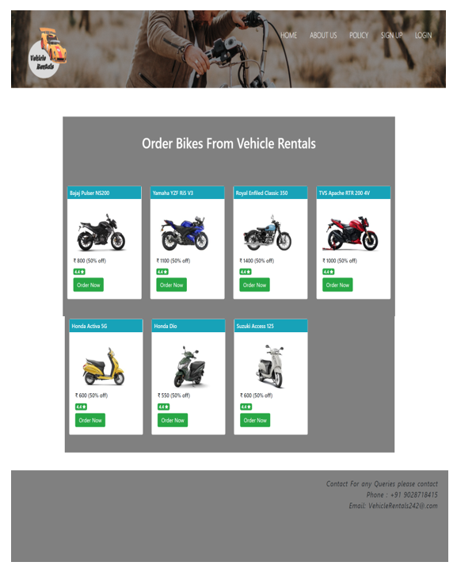
Order Bikes
The bikes are contain are under 50% off offer .
This form contains the bikes which the user can order bikes of his /her choice.
And the rattings of the bikes are also shown so the user can make proper choice.

Slide 13
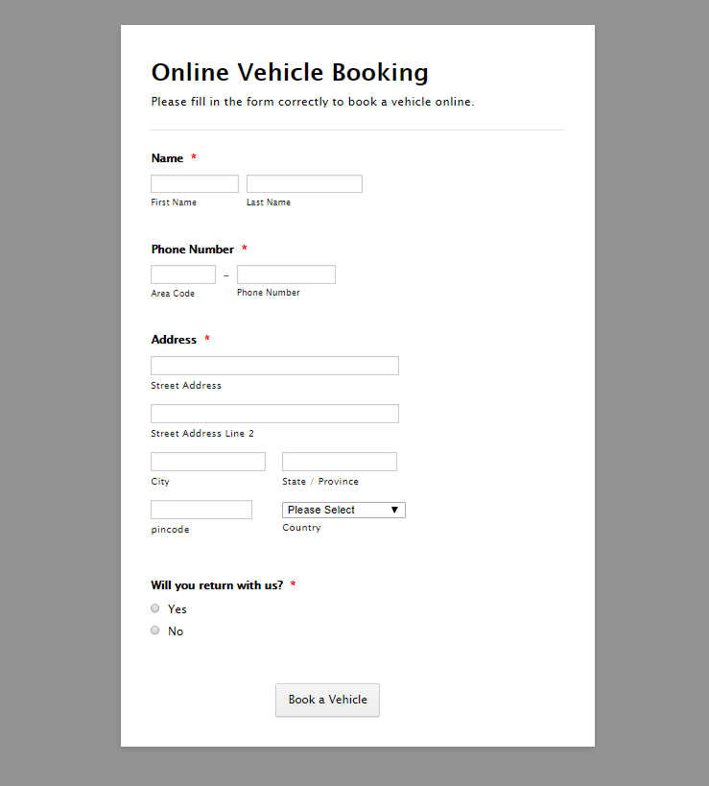
Booking Form
This is the booking form where you can book your vehicles. The user has to fill the correct information to book the vehicle

Slide 14
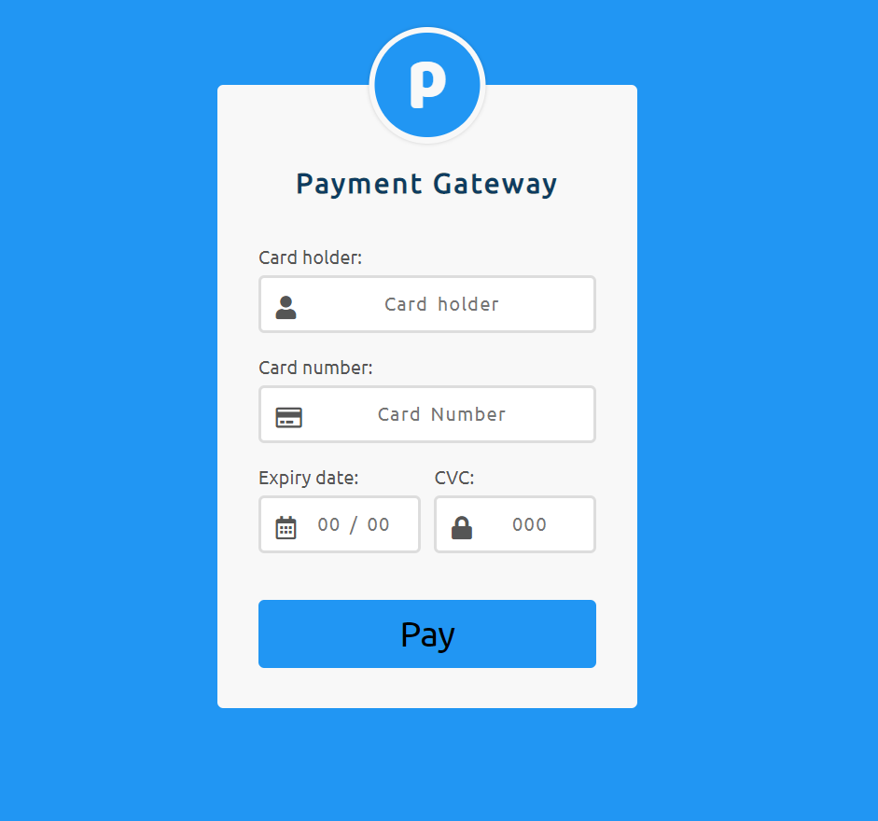
Payment Form
After successful booking the user have to pay the amount.

Slide 15
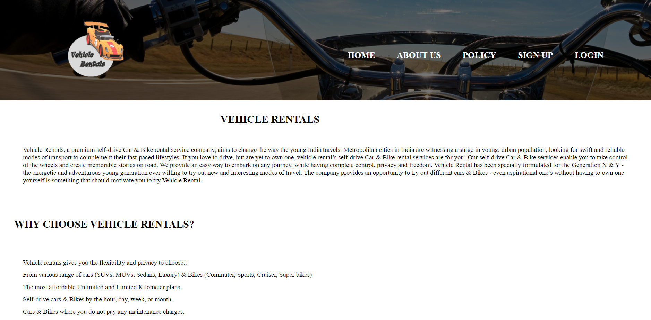
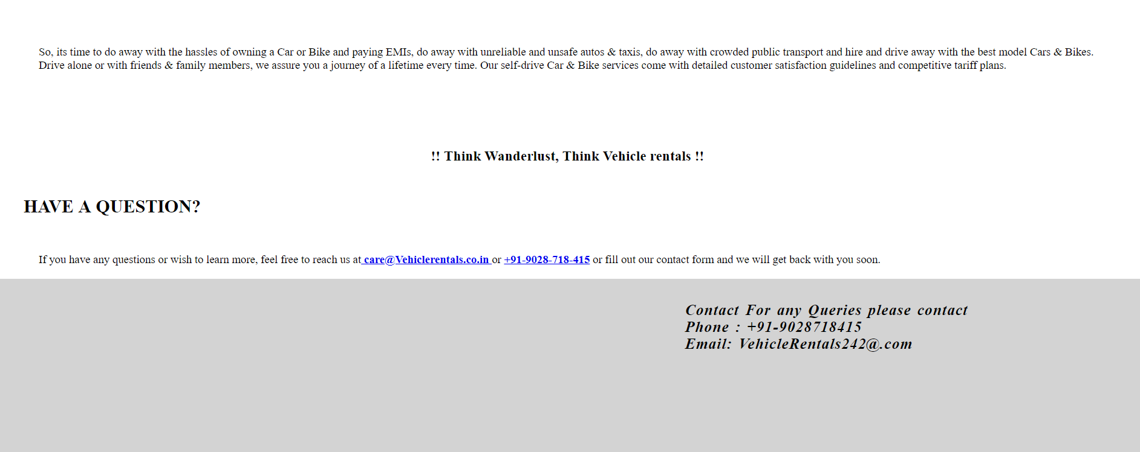
About Us Page
In this form the information about the organisation is shown.

Slide 16
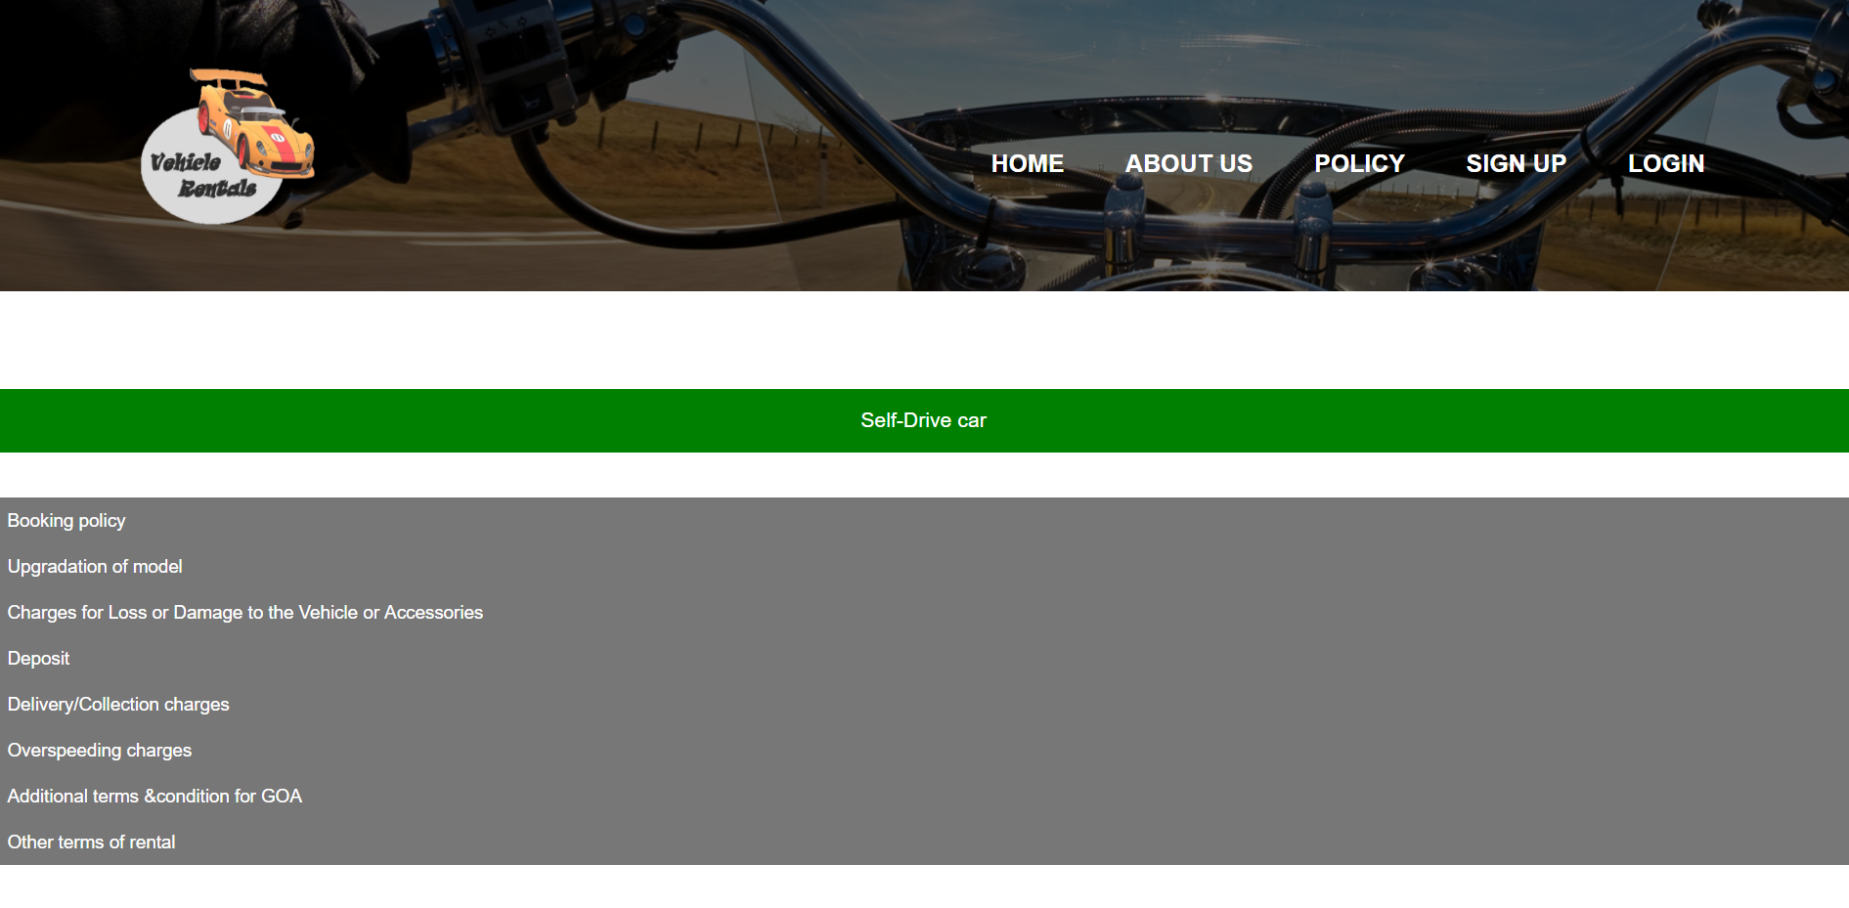
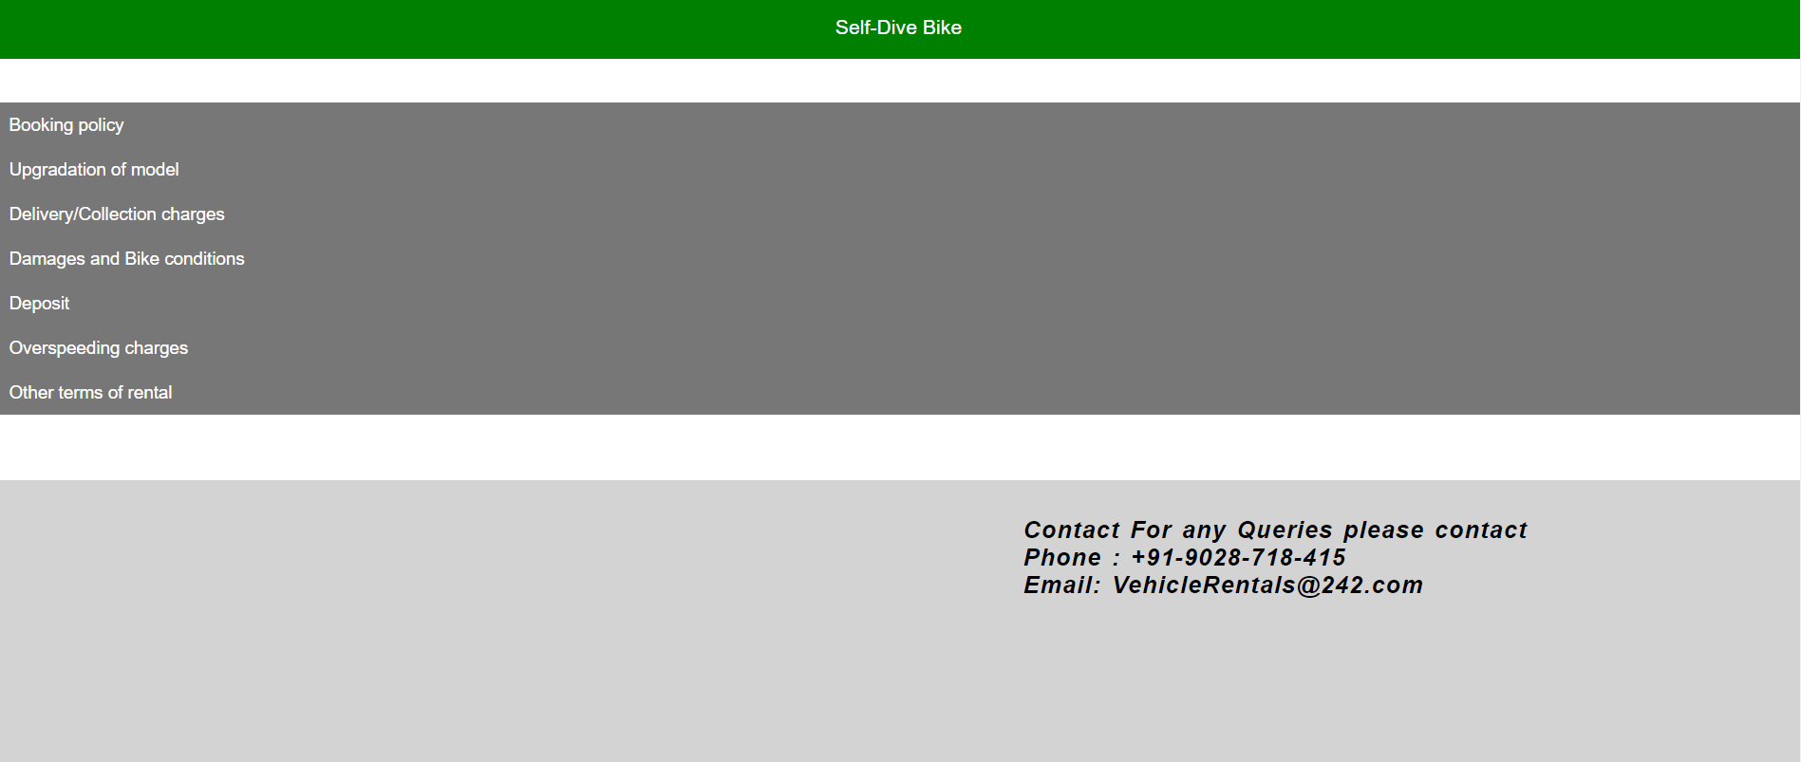
Policy Page
This form shows all the policy regarding the organisation.

Slide 17
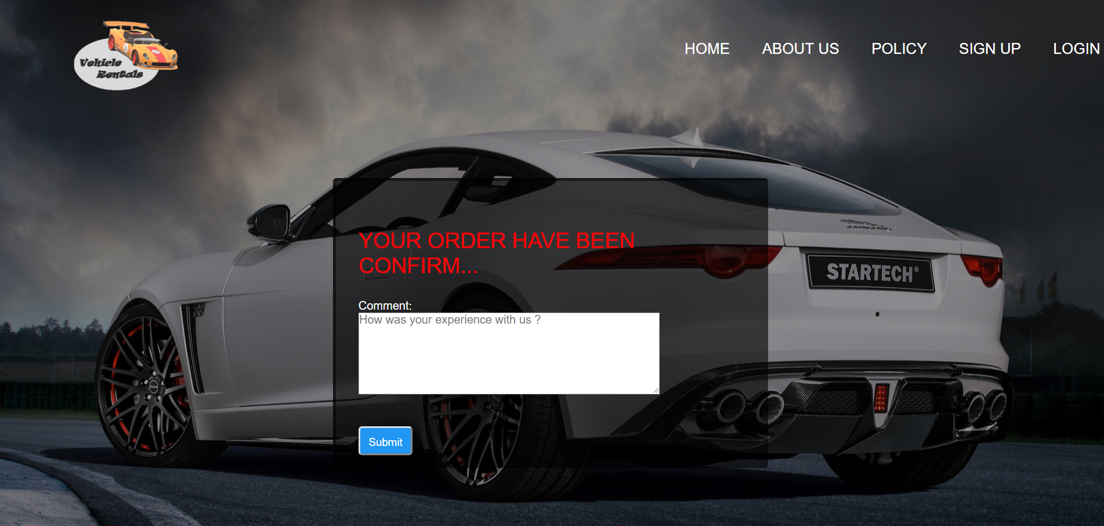
Confirm order Page

Slide 18
!!!... Thank you …!!!

